Slide 1
groopit.co

Slide 2
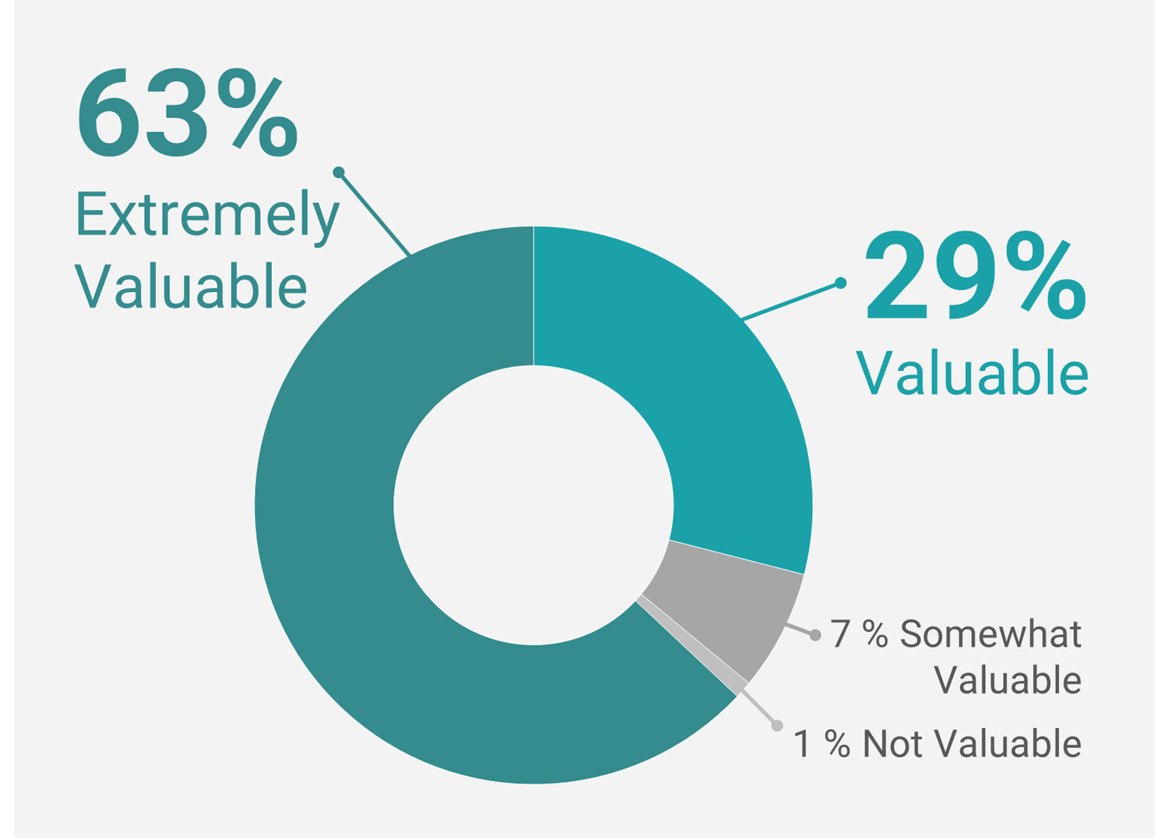
2023 State of Competitive Intelligence Report
Employees closest to customers have a wealth of valuable intel
Employees are the #1 most valuable source of competitive intel
Outsmart competitors
Improve customer experience
Increase sales
Forrester Research
88% of opportunities & threats go unnoticed.

Slide 3
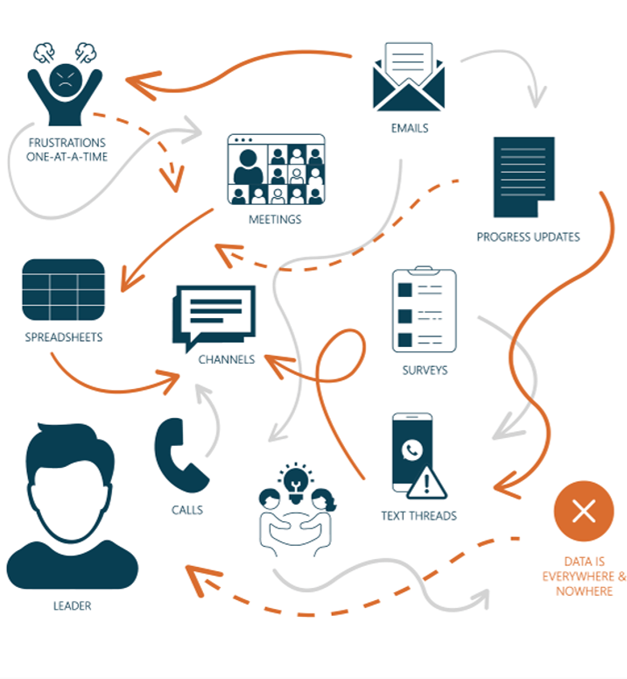
Challenge is getting and using the intel employees have
Lost in ad-hoc data chaos
Manually piece together fragments Employees forget, resist, don’t engage

Slide 4
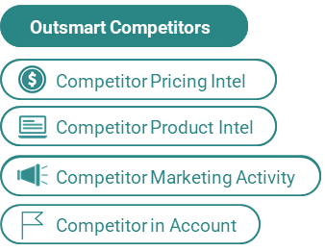
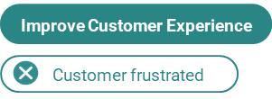
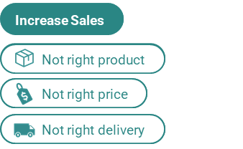
Groopit simplifies how companies get and use intel from employees to transform results
Underlying data model
Integrated across systems
Real-time sharing & usage
Notes:
Groopit solves this problem in a radically simple way It starts by establishing an underlying data model, so you’re getting precisely the right information. To outsmart competitors, the data model typically starts with a data model for pricing, product, and sales intel.
Then, it’s integrated across enterprise systems -- in your case that would be [salesforce] and [slack}.
Finally, it all happens in real-time [waze analogy]
Groopit eliminates all of the friction - the manual, laborious tasks are removed for the administrator AND the sharing is simplified to a few taps, less than a minute, from wherever employees work - so insights aren’t lost in the ad-hoc chaos, and can be used on demand.

Slide 5
Product Demo
Share this 5-minute demo with key stakeholders.

Slide 6
Data model is essential to simplifying how insights are shared and used.
Traditional Limitations
Groopit Benefits
Groopit Outcomes
 | Insights into ad-hoc chaos
 | Manually piece together together fragments
 | Employee resistance
Groopit aggregates insights across systems and delivers to appropriate decision-makers. | Less time collecting, finding, managing, tagging, synthesizing.
Groopit yields high-quality, quantitative, structured data, stored in one place. | Full visibility to insights
Groopit simplifies sharing from anywhere and makes insights easy to consume, search, use. | Increased insight sharing & usage, which drives results.
Take a look at The Business Case for Groopit

Slide 7
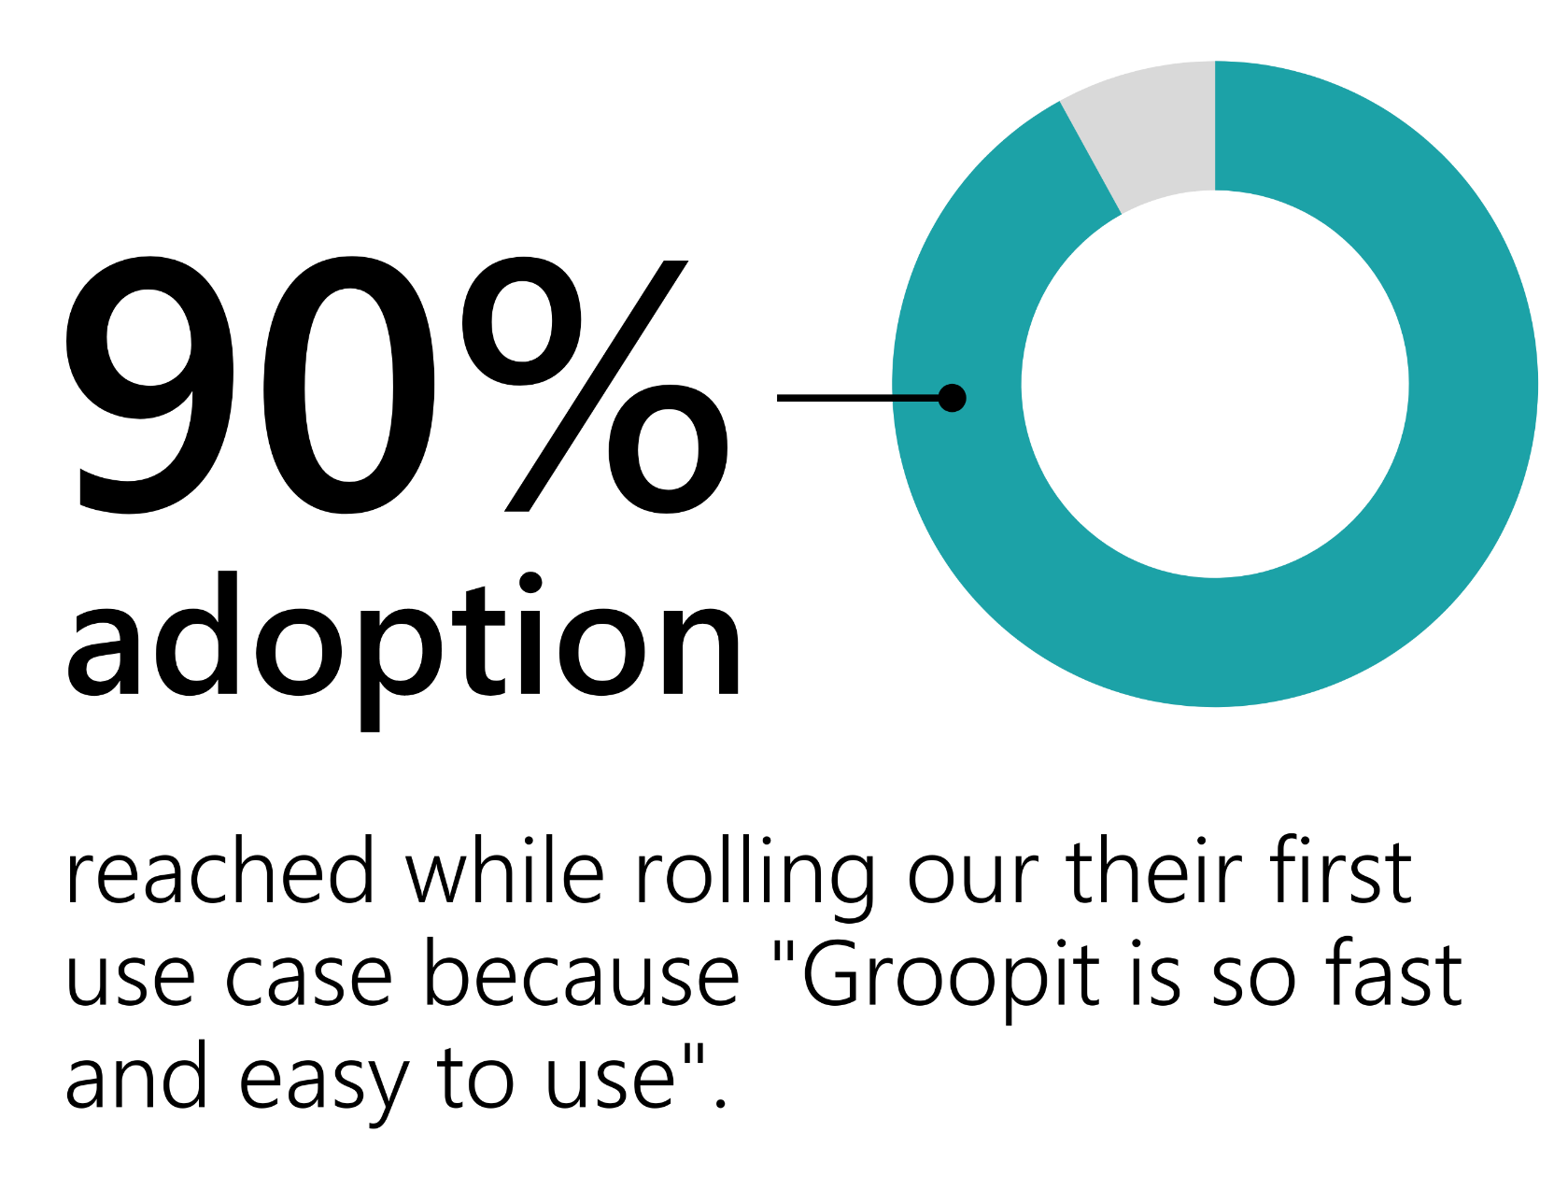
Trusted by recognized brands
Groopit is the fastest way to get real-time product feedback and data for insights that are hard to quantify.
Emma Brumley, Scrum Master
Check out the Guidant Financial Case Study

Slide 8
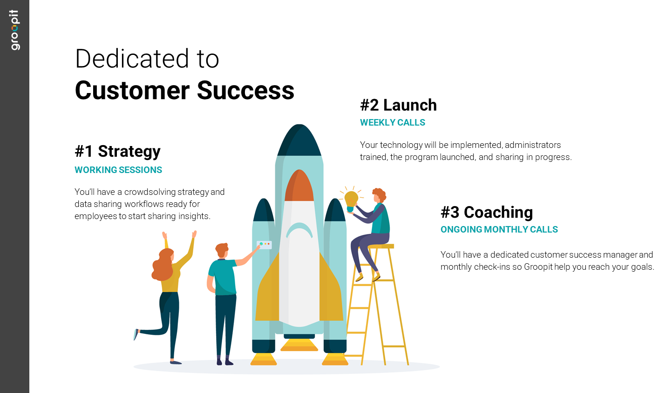
Leverage ideas in Groopit Launch Playbook.

Slide 9
Choose the investment that’s right for you:
Business
$12k/year 5 Data Sharing Workflows Up to 500 Contributors SSO, Slack, Teams + Add-Ons
Business + Salesforce
$27k/year 5 Data Sharing Workflows Up to 500 Contributors SSO, Slack, Teams + Add-Ons + Groopit for Salesforce App
Enterprise
$45k/year 10 Data Sharing Workflows Unlimited Contributors SSO, Slack, Teams, Salesforce + Add-Ons
Access pricing details online.

Slide 10
hello@groopit.co | groopit.co
Read the Crowdsolving Whitepaper to learn more about this new category of enterprise software.

Slide 11
SCREENSHOTS FOR REFERENCE

Slide 12
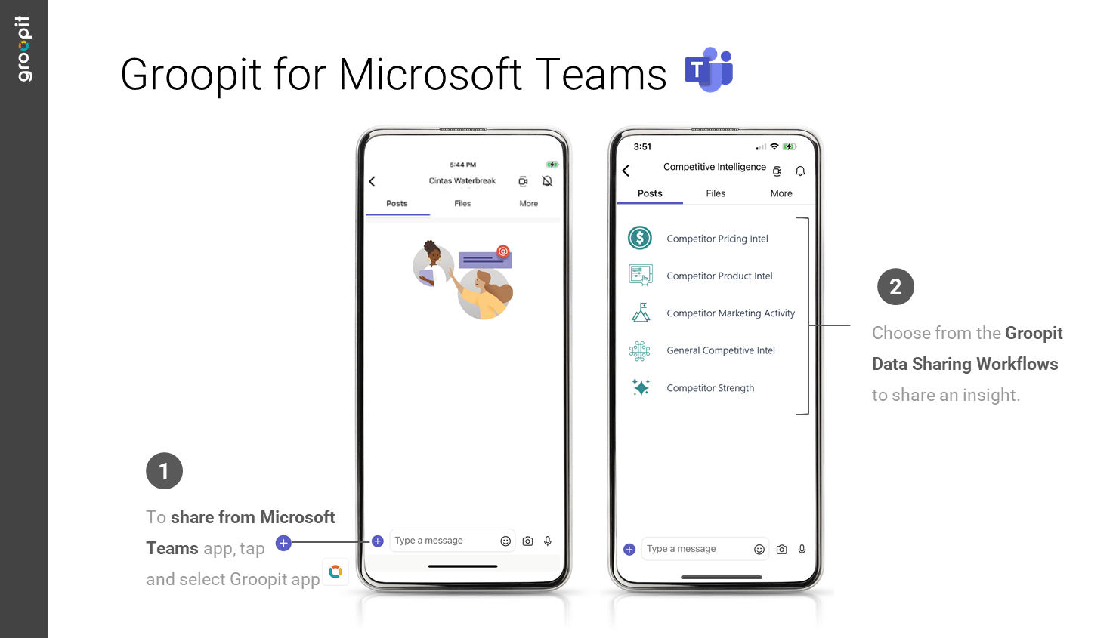

Slide 13
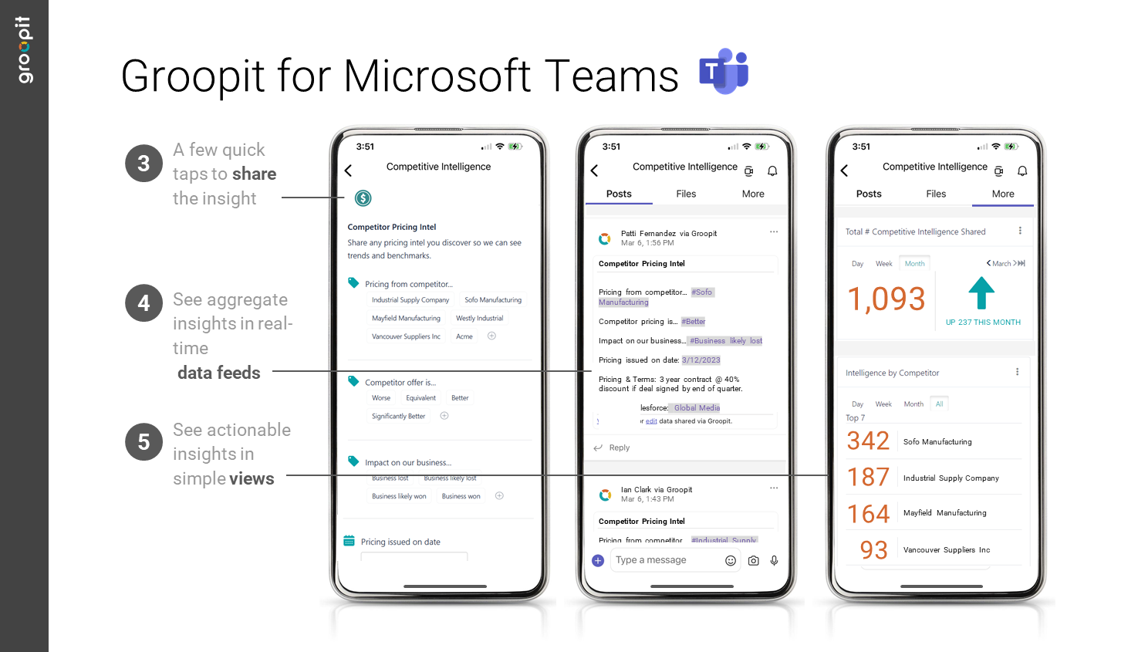

Slide 14
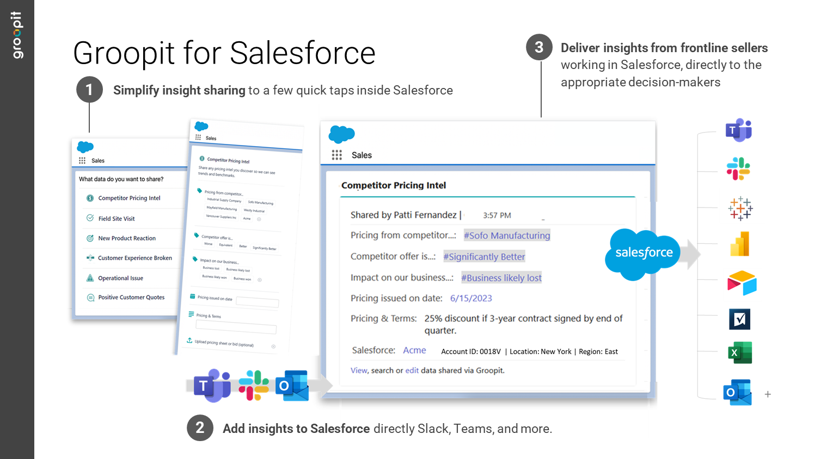

Slide 15
